Slide 1

DESIGNING INNOVATIVE PRODUCTS FOR EMPOWERING THE DELIVERY WORKFORCE
Join us as we explore the future of delivery, where technology and design work together to empower and optimize the workforce.
TEAM ID: TEM4854
TEAM MEMBERS:
ARTHI NANDHANA A
ABISHEK A
HARI PRASATH V
ASWIN S

Slide 2


Problem Statement :
Challenges and struggles faced in
delivery workforce.
Problem Solution :
To develop an safety system and integrated health monitering for delivery workers that tracks well-being, fatigue and environmental risks in real time to reduce accidents and enhance safety.

Slide 3
Understanding the delivery workforce
Challenges and struggles
Delivery workers face numerous challenges that impact their safety, efficiency and well being. These include:
Technological challenges
Time constraints
Physical challenges
Safety risks
Meeting tight delivery deadlines can lead to stress and a feeling of being constantlly rushed which increases the blood pessure rapidly.
Traffic hazards: Accidents due to traffic or poor road conditions.
Unsafe delivery locations: navigating poorly lit or dangerous areas.
Navigation Errors: Inaccurate GPS directions or unfamiliar routes
lack of real-time communication during emergencies exacerbates worker anxiety.

Slide 4
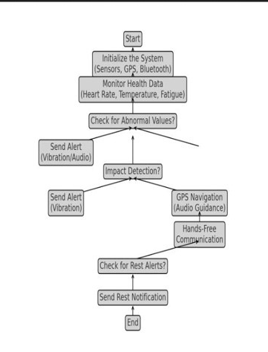

Wearables are smart devices worn on the body that monitor, assist or enchance daily activities through integrated sensors and technology.
Wearables designed for the safety of delivery workers focus on reducing risks and improving well-being during shifts.
Key features include:
GPS Tracking
- TRACKIMO GPS TRACKER
Fall Detection
- ACCELAROMETER
Fatigue Monitering
- TEMPERATURE SENSOR
Hands-free Communication
- BLUETOOTH, MICROPHONES
Proximity and Hazard Alerts
- ULTRASONIC, RADOR SENSORS
Emergency Alerts
- CRASH SENSORS

Slide 5
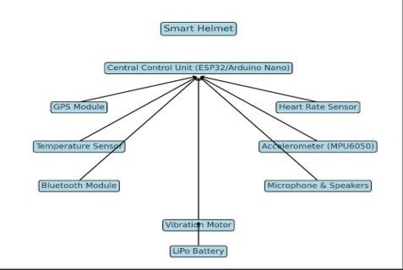
Technical Approach
To reduce work pressure on delivery workers using smart helmets, a well-rounded technical approach focuses on optimizing workloads.
AR display provides real-time navigation without requiring workers to glance at their phones. Turn-by-turn directons are projected onto the visor.
Noise-Cancelling Microphone enables clear communication even in noisy traffic environments.
Technology stack
Sensors
GPS
Bluetooth
Cameras
Displays
Sensors monitor UV exposure and helmet temperature, alerting the worker to take protective measures when necessary.
Equipped with infrared vision to improve vision to improve visibility in low-light conditions, enhancing safety for night deliveries.

Slide 6
Market Needs for Smart Helmets:
Safety and Security: Enhanced crash detection, improved visibility, Real-time traffic updates.
Convenience and Comfort: Hands-free navigation.
Health and wellness: Biometric Monitoring, Fatigue monitoring.
Additional features: Integration with other devices, Customizable settings, Water-resistant design.
Target Users:
Safety and Security: Enhanced crash detection, improved visibility, Real-time traffic updates.
Convenience and Comfort: Hands-free navigation.
Health and wellness: Biometric Monitoring, Fatigue monitoring.
Additional features: Integration with other devices, Customizable settings, Water-resistant design.
Delivery drivers: E-commerce, food delivery and courier service personnel working on motorcycles and bicycles
Motorcyclists: Commercial and individual riders looking for enhanced road safety and navigation.
Logistics workers: Drivers involved in last-mile deliveries or long-haul transportation.
Feasibility:
The product uses cheap and open source components, which are readily available in the market.
It uses a technology, which can easily be configured. Hence it is proved to be technically feasible.
Since the model is used, there is no need to use the hand to control the basic mobile functionalities.

Slide 7
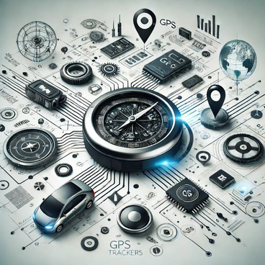




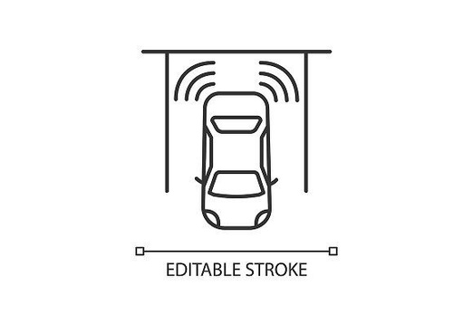


Project Prototype
TRACKIMO GPS Tracker
Accelarometer
Temperature Sensor
Bluetooth
Microphone
SMART HELMET
Ultrasonic Sensor
Crash Sensor
Radar Sensor

Slide 8
IMPACTS
Project value
Smart helmets offer significant benefits to delivery workers, including enhanced safety through real-time monitering and environmental sensors. However, these advantages are tempered by potential drawbacks such as
-> High cost
->Privacy concerns
->risk of Technical malfunctions
->Added weight might reduce comfort
These smart helmets can provide advanced features including impact detection, real-time monitoring, early warnings that can prevent accidents.
They are equipped with an SOS feature for immediate distress alerts, ensuring rapid response in critical situation.
Health metrics monitoring in another pivotal aspect, offering a safeguard against potential health risks.
Future potential
monitor finances
A magazine is a periodical publication, which can either be printed or published electronically.
Voice Controlled Navigation: Smart helmets could provide vice-controlled navigation, allowing riders to focus on the road.
Biometric Monitoring: Smart helmets could monitor vital signals such as heart rate and blood pressure, to ensure the rider’s safety and well-being.
Fatigue Detection: Smart helmets could detect signs of fatigue and alert the rider to take a break.

